Slide 1
Exception Handling in Java
@Author
#TechieMit
Like ,Comment and Subscribe to #TechieMit

Slide 2
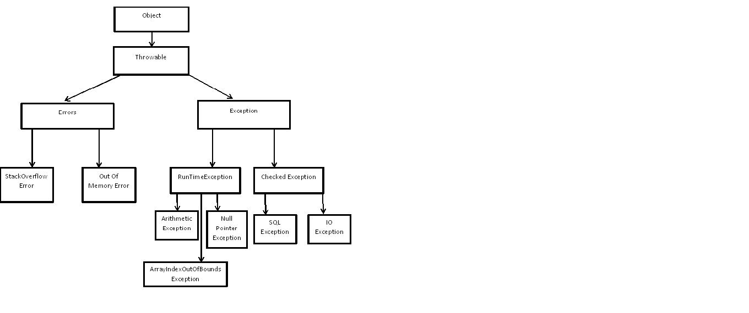
Exception Hierarchy Class Diagram

Slide 3
Exception and its Meaning
Exception is event occurs during execution of program causing abnormal termination of program
SQLException,StringIndexOutOfBoundsException,NullPointerException are examples of Exception
Errors are usually caused by serious problems that are outside the control of the program, such as running out of memory or a system crash.
OutOfMemoryError,StackOverflowError are examples of Error

Slide 4
Checked Exception
A checked exception is an exception that can be checked during compilation time.If programming code throws a checked exception it will be handled within the program using try-catch construct or explicitly specify that method might throw an Exception using throws keyword.
IOException,SQLException,ClassNotFoundException,FileNotFoundException are examples of checked exceptions in java

Slide 5
Unchecked Exception
A unchecked exception is an exception that occurs at runtime hence they cannot be checked during compilation time.If programming code throws a unchecked exception it will result in abnormal termination of program.They can explicitly thrown using throw keyword
ArithmeticException,NullPointerException,DateTimeException,ArrayIndexOutOfBoundException,StringIndexOutOfBoundException are examples of checked exceptions in java

Slide 6
try block
Try block is used to indicate the block that might contain exceptions
So in order to declare exceptions or conditions that can cause exceptions to occur are specified in try block
Syntax of try-catch-finally block
try
{
//Exceptions
}
catch(Exception ex)
{ // Exception Handling message
}
finally
{
// Clean up code
}

Slide 7
catch block
catch block is used to catch the exceptions that are thrown in try block
The argument type, ExceptionType, declares the type of exception that the handler can handle and must be the name of a class that inherits from the Throwable class. Syntax of catch block
try
{
//Exceptions
}
catch(ExceptionType ex)
{ // Exception Handling message
}

Slide 8
finally block
finally block is the block that is guaranteed to be executed regardless of the exception that might occur in try block
finally block can contain messages that user need to give before program termination.Mostly used to clean-up opened resources in try block.It might be optionally be called after catch block or directly with try block
try
{
//Exceptions
}
finally
{
System.out.println(“Finally block executed”);
fop.close(); //This closes the open stream in try block
}

Slide 9
throw keyword
throw keyword is used to explicitly throw an exception
We may throw checked or unchecked exception/User defined exception using throw keyword
try
{
FileReader file = new FileReader("C:\\Users\\SamplePrograms\\Desktop\\sample.txt");
BufferedReader fileInput = new BufferedReader(file);
throw new FileNotFoundException();
}
catch(Exception ex)
{
System.out.println(ex.getMessage());
}

Slide 10
throws keyword
throws keyword is used to declare an exception
finally block can contain messages that user need to give before program termination.Mostly used to clean-up opened resources in try block.It might be optionally be called after catch block or directly with try block
void method()throws IOException{
throw new IOException("device error");
}

